Slide 1
“Team Enviroshutter”
2008 ANIMATION STORYBOARD
Team 179
Children of the Swamp

Slide 2
Table of Contents
Baseline Storyboard
Team 179 Animation Process
Individual Scenes
Brainstorming Ideas
Credits

Slide 3
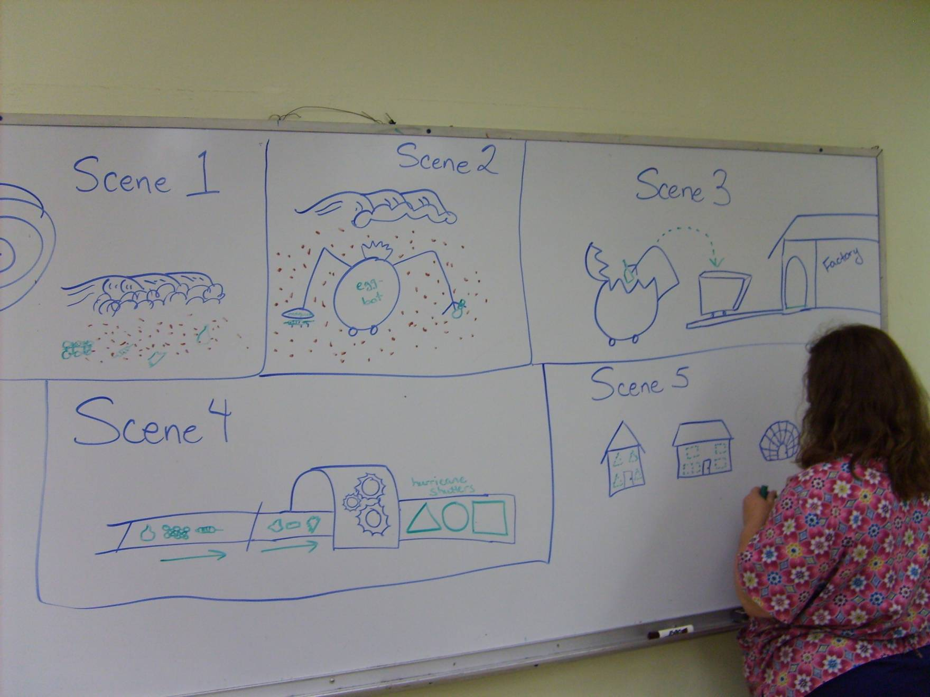
Basic Storyboard

Slide 4
Team 179 Animation Process
Team brainstorms ideas based on theme and Autodesk options.Team is
encouraged to take ideas home and think of additional ideas and come
back with their own storyboards.
Students present their own storyboards to the Team. Team chooses favorite
Ideas from multiple storyboards. Ideas that are to be used are written down.
Baseline storyboard is created from written down ideas.
Baseline storyboard is divided into scene segments.
Animators and Mentors decide which segments each animator will work on.
Segments are reviewed and revised.
Dialog is created based on storyboard and segments.
Segments are continued to be reviewed and revised.

Slide 5
Team 179 Animation Process (continued)
Dialog is performed by students in taping sessions.
Segments are continued to be reviewed and revised.
Music is created and performed in taping sessions.
Segments are reviewed and revised.
Title Page and Credits are created.
Segments are finalized and rendered.
Segments are connected to create animation.
Dialogue is added to the attached segments.
Music is added to animation.
Title Page and Credits are added to animation.
Animation is saved as per filename specification.
Animation is Uploaded.

Slide 6
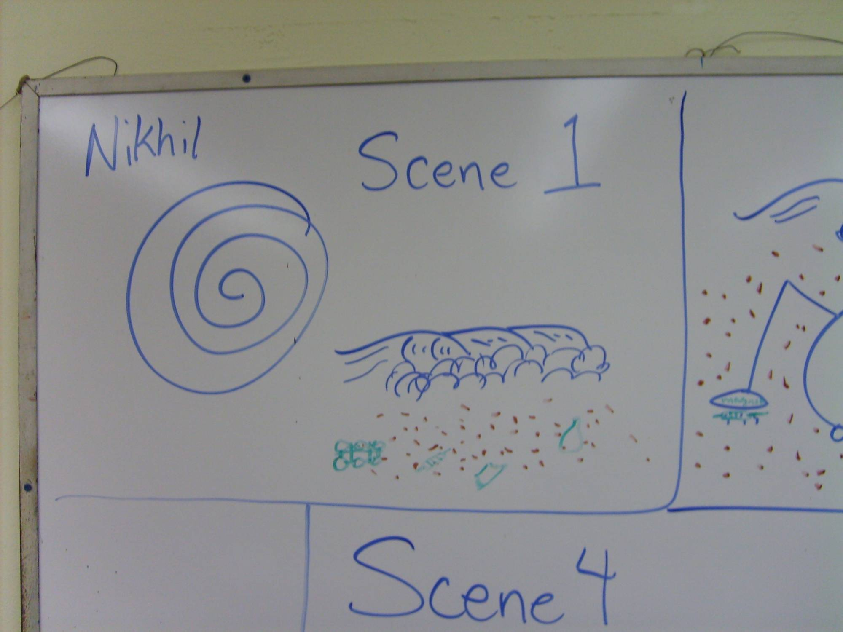
Nikhil will work slide 1 with the incoming Hurricane
Satellite Hurricane scene panning down through to the beach.

Slide 7
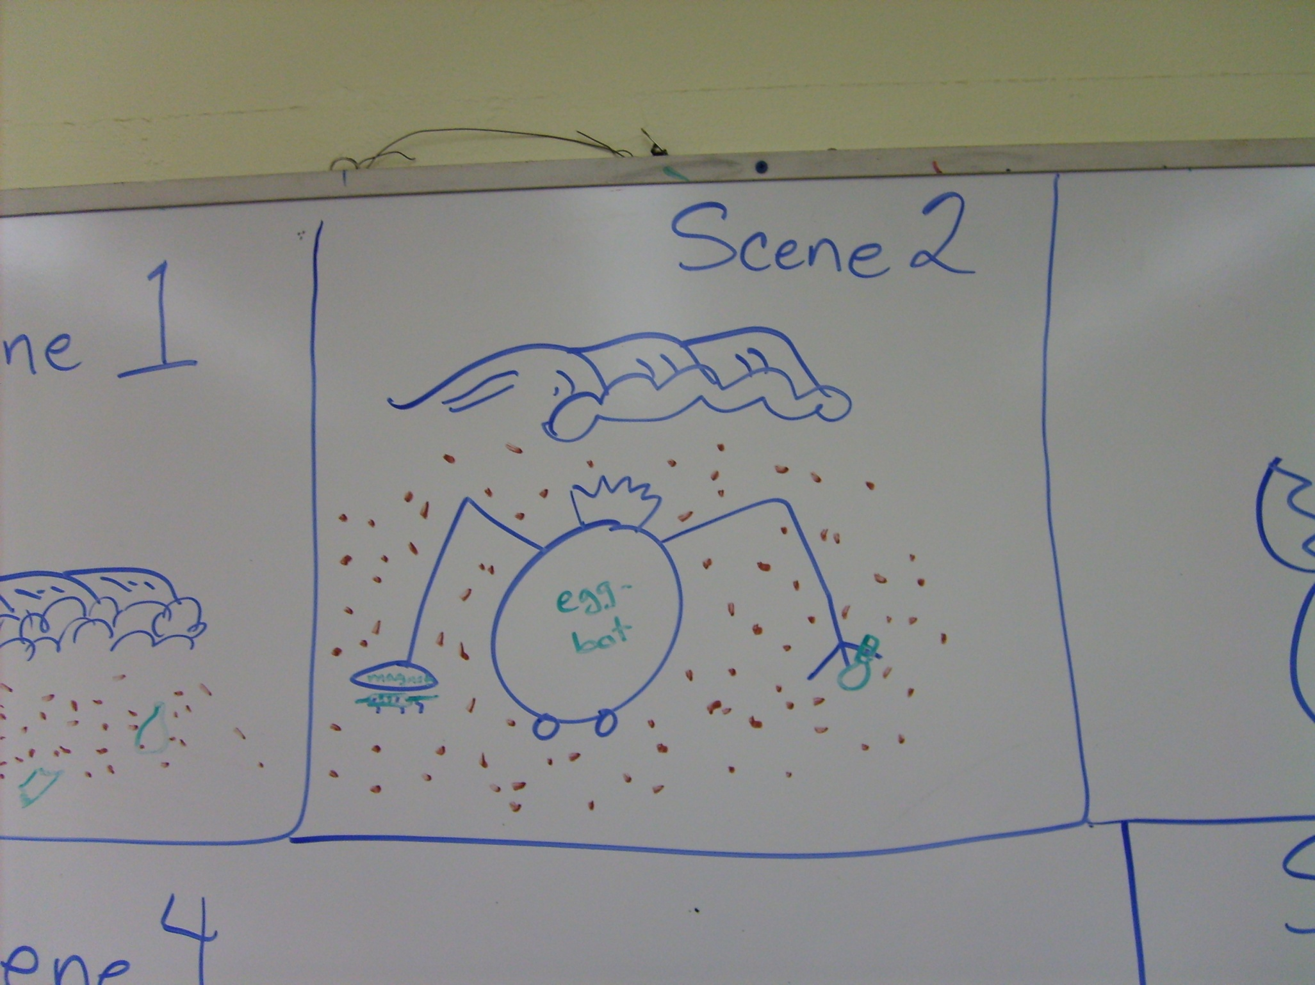
Nikhil will work scene 2 with the beach
Focusing down with the segment with the cleanup robot.
Nikhil will create the cleanup robot
Alex will create the Beach debris

Slide 8
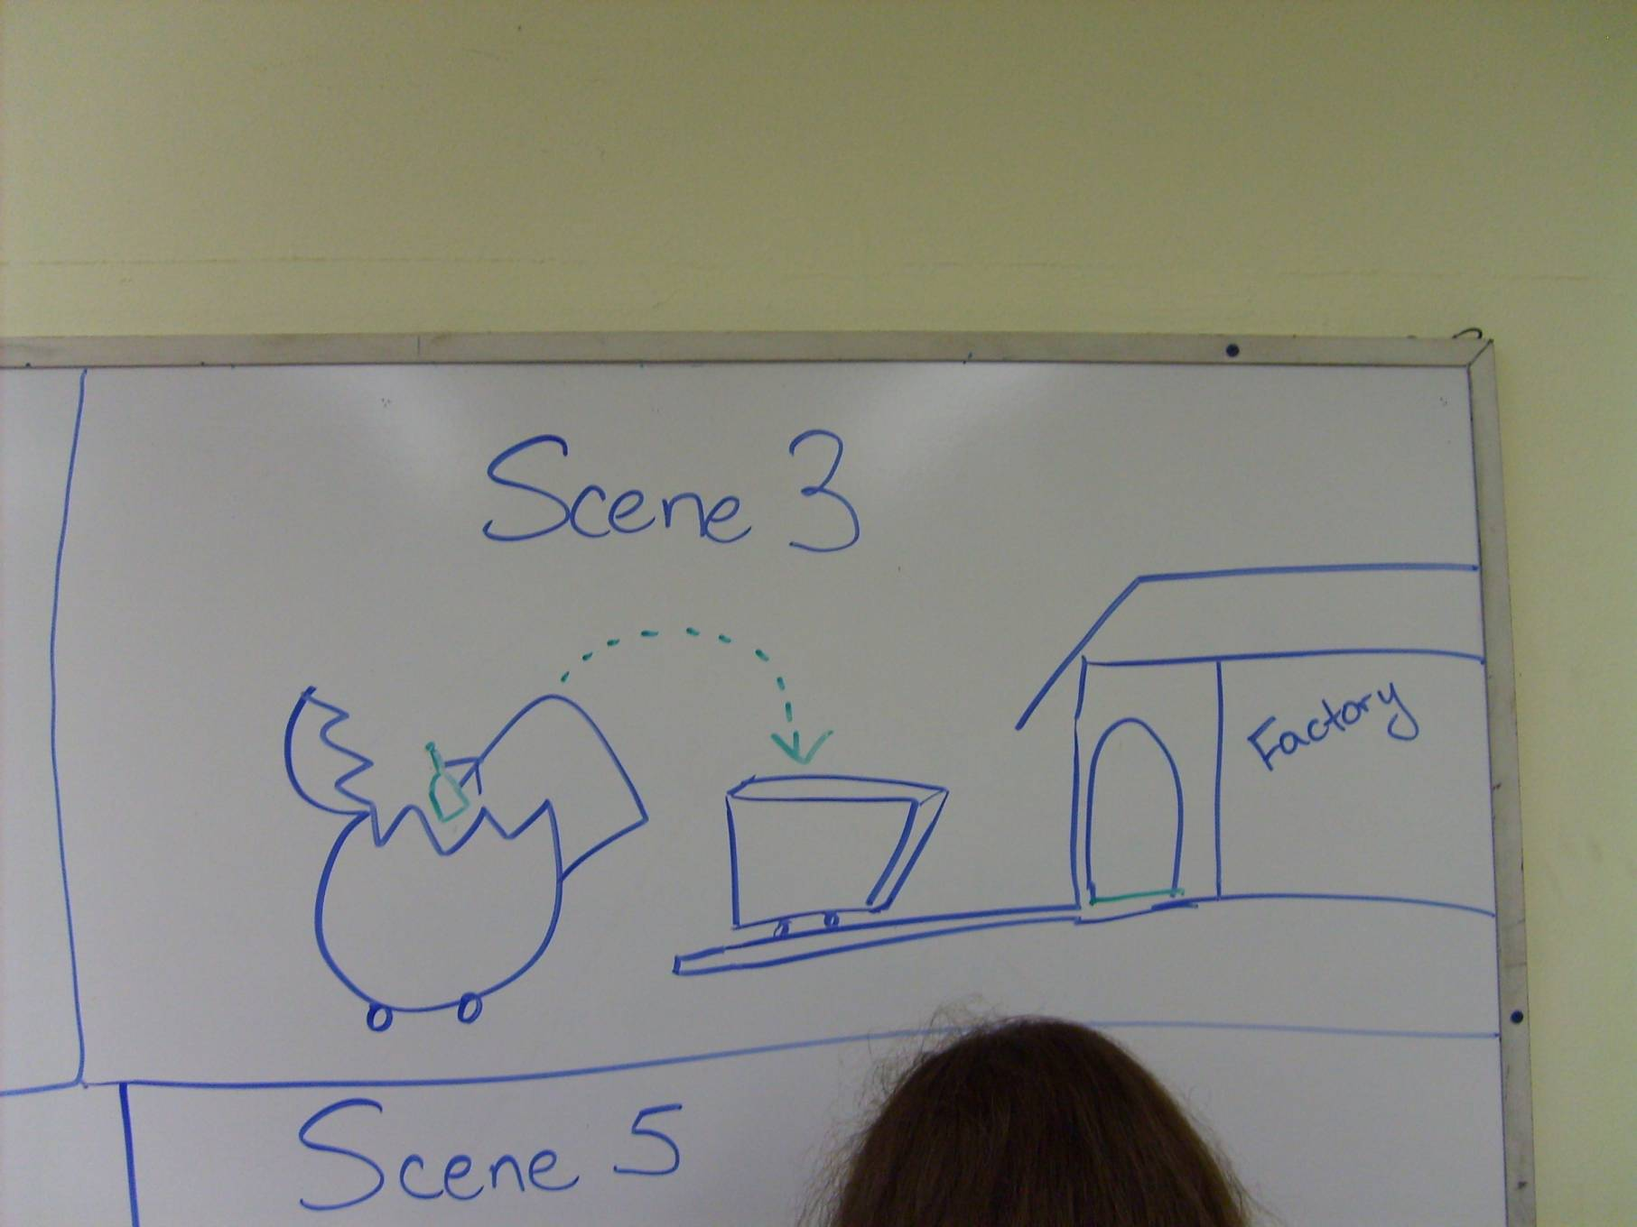
TJ will work scene 3 robot with the cleanup robot load deposited at factory.

Slide 9
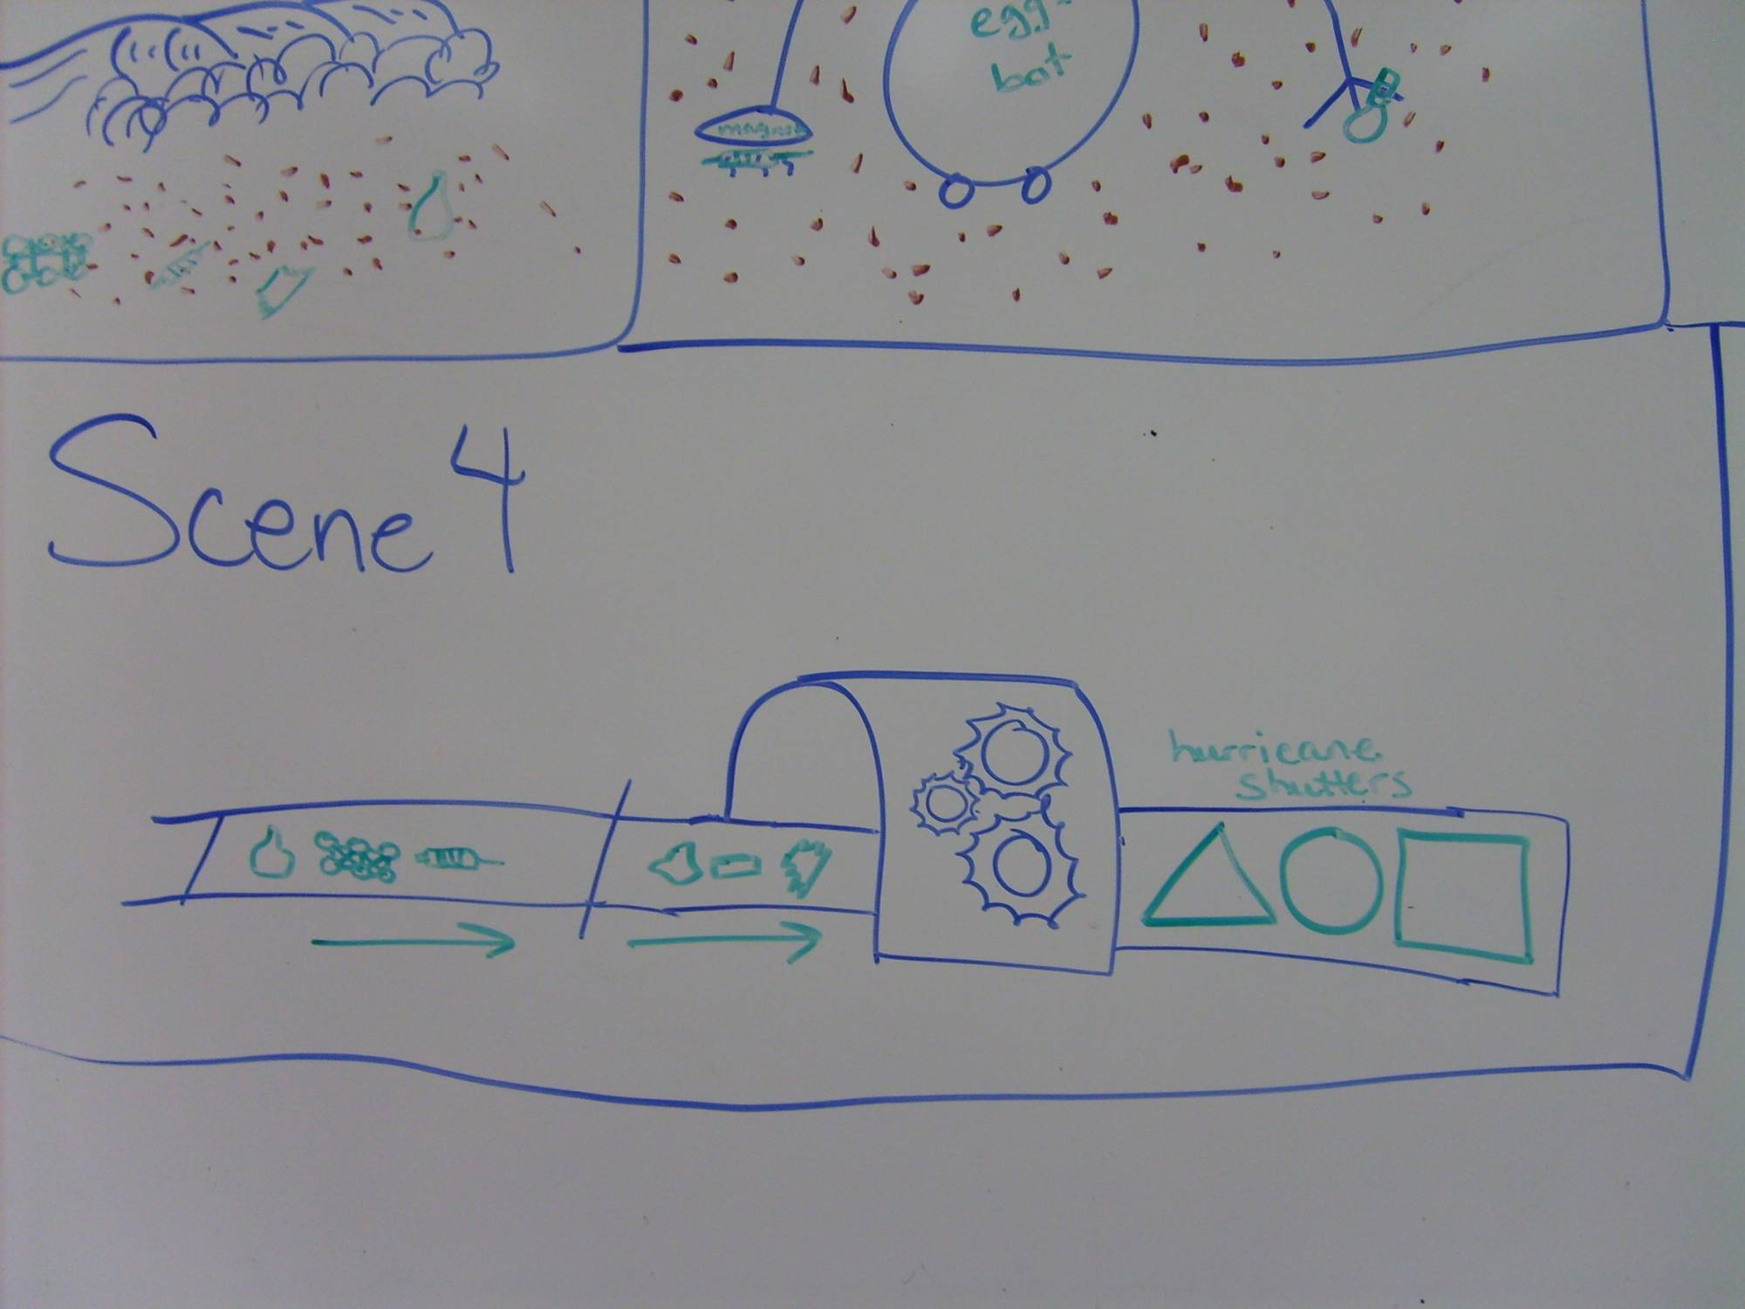
TJ will work scene 4 with the factory creating shutters

Slide 10
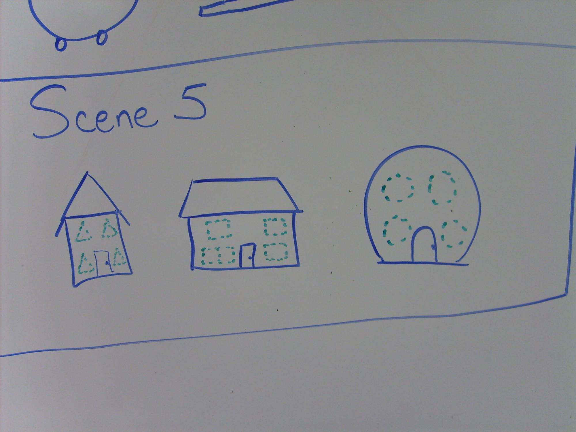
Nikhil will work scene with the incoming Hurricane shutters on buildings. Alex will create some buildings.

Slide 11
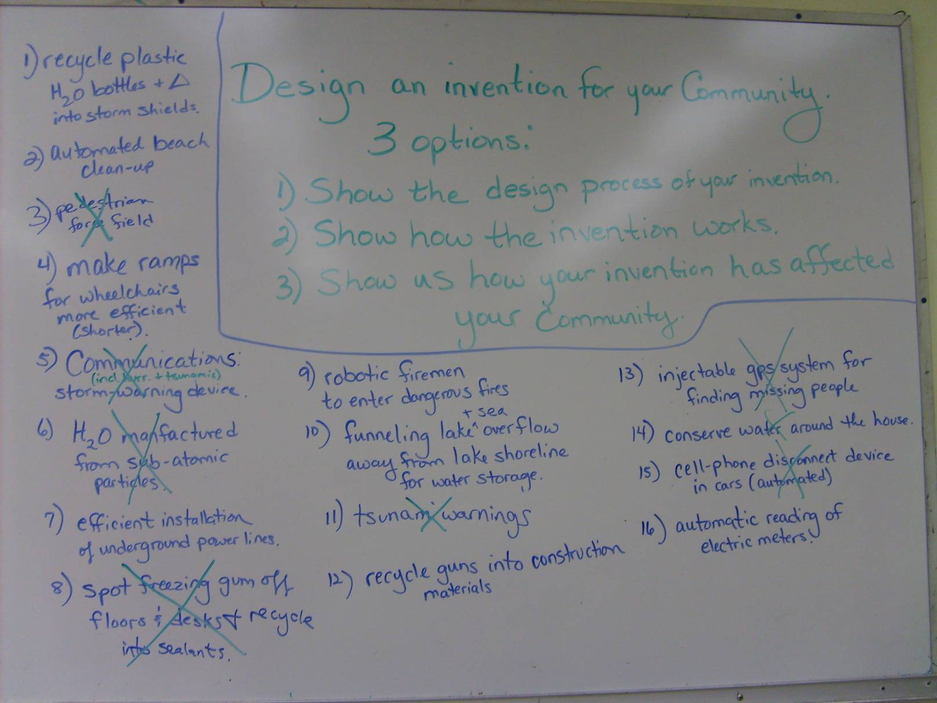
Brainstorming Ideas

Slide 12
CREDITS
ANIMATION TEAM:
Students
Nikhil Ollukaren
Thomas J. Wilson
Marissa Runkle
Alex Nicoleau
Mentors
Roy Bays
Paul Ollukaren
Mark Gross
Lydia Runkle
Jayne King
August Nicoleau
ANIMATORS:
Nikhil Ollukaren
Thomas J. Wilson
VOICES:
Narrator
Marissa Runkle
STORYBOARD:
Lydia Runkle
CREATIVE DIRECTOR:
Jayne King
MUSIC:
Jayne King

